Slide 1

Context-Aware Explainable AI Curator for Virtual Museums using Retrieval-Augmented Generation
• Prof Deepanramkumar
• School :SCOPE
• Date of Review: 29 july,2026
SHRIYA GARG 23MID0169
ARYAN SINHA 23MID0088

Slide 2

Introduction
  Virtual museums preserve and showcase cultural heritage using AR, VR, and AI.
  AI-powered virtual guides enable natural language interaction with exhibits.
  Retrieval-Augmented Generation (RAG) improves response accuracy by retrieving information from verified museum knowledge sources.
  Existing AI systems often lack transparency, making it difficult for users to trust the generated responses.
  Explainable AI (XAI) enhances trust by providing source attribution and reasoning behind AI-generated answers.
  Proposed Solution: Develop a Context-Aware Explainable AI Curator that combines AR, RAG, and XAI to deliver personalized, accurate, and explainable museum experiences.
  Each response includes:
  📌 Source exhibit
  📄 Reference document
  📊 Confidence score
  💡 Explainable reasoning

Slide 3
IMPORTANCE OF THE RESEARCH TOPIC
Digital museums are becoming increasingly popular due to their accessibility, educational value, and ability to reach global audiences. Visitors expect AI-powered museum guides to provide accurate, context-aware, and trustworthy information about artifacts and historical events.
Integrating RAG with Explainable AI offers several benefits:
  Increases user trust by showing the evidence behind every response.
  Reduces misinformation and AI hallucinations by grounding answers in verified museum documents.
  Enhances learning by allowing visitors to trace information back to the original exhibit.
  Supports museum curators by providing transparent AI assistance rather than opaque automated responses.
  Improves visitor engagement through personalized, context-aware interactions while maintaining credibility.
This research contributes toward building AI systems that are not only intelligent but also transparent, accountable, and suitable for cultural heritage applications.

Slide 4

CURRENT CHALLENGES IN THE SELECTED DOMAIN
  Lack of Explainability: Most conversational AI systems provide answers without indicating their source or reasoning process, making it difficult for users to verify information.
  Hallucinated Responses: Large Language Models may generate plausible but incorrect historical facts when reliable evidence is unavailable.
  Limited Context Awareness: Existing systems often fail to consider the visitor's current exhibit, interests, or conversation history, resulting in generic responses.
  Insufficient Source Attribution: Many museum chatbots do not reference the exhibit or document from which information was retrieved, reducing transparency.
  Low User Trust: Without confidence scores or explanations, users may hesitate to rely on AI-generated historical information.
  Fragmented Integration: While RAG and XAI have been individually explored, their combined implementation within immersive virtual museum environments remains limited.

Slide 5


Slide 6
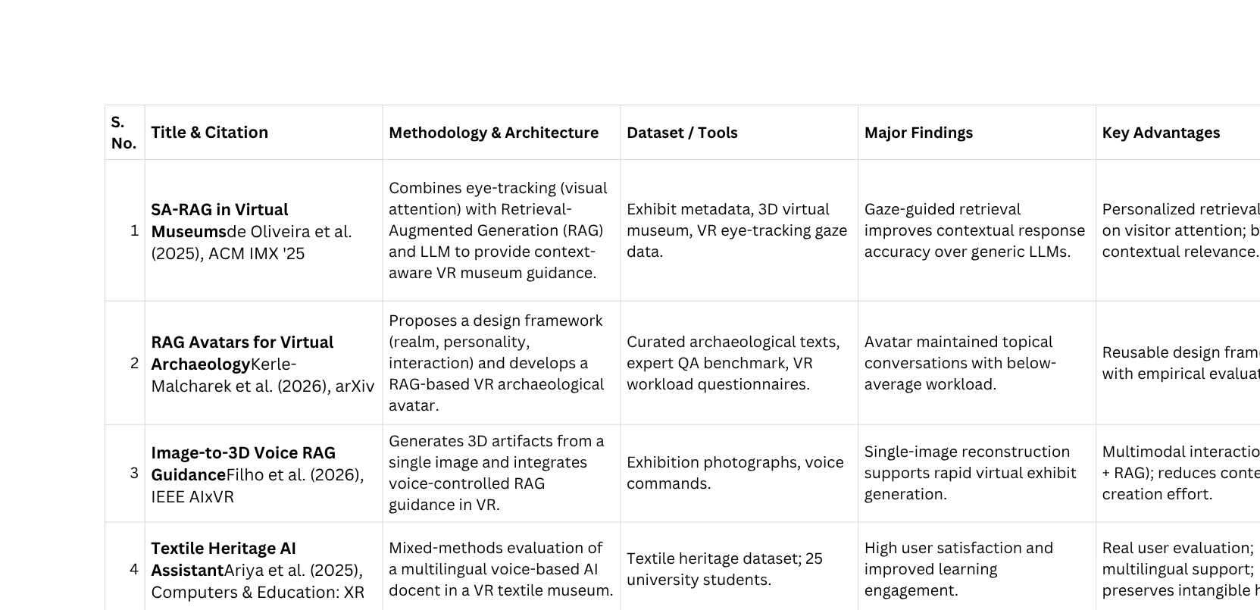

Slide 7
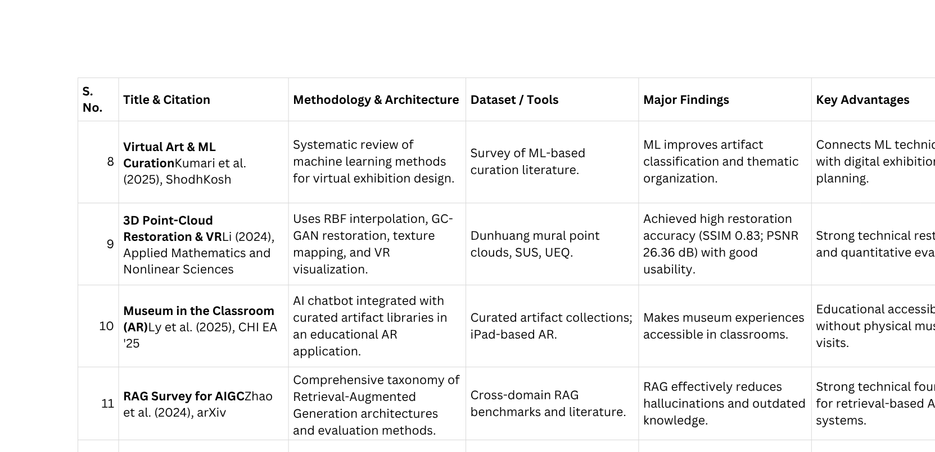

Slide 8
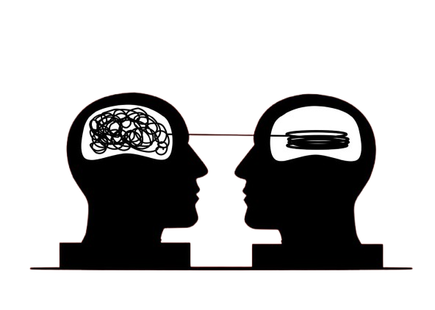
COMPARATIVE ANALYSIS

Slide 9
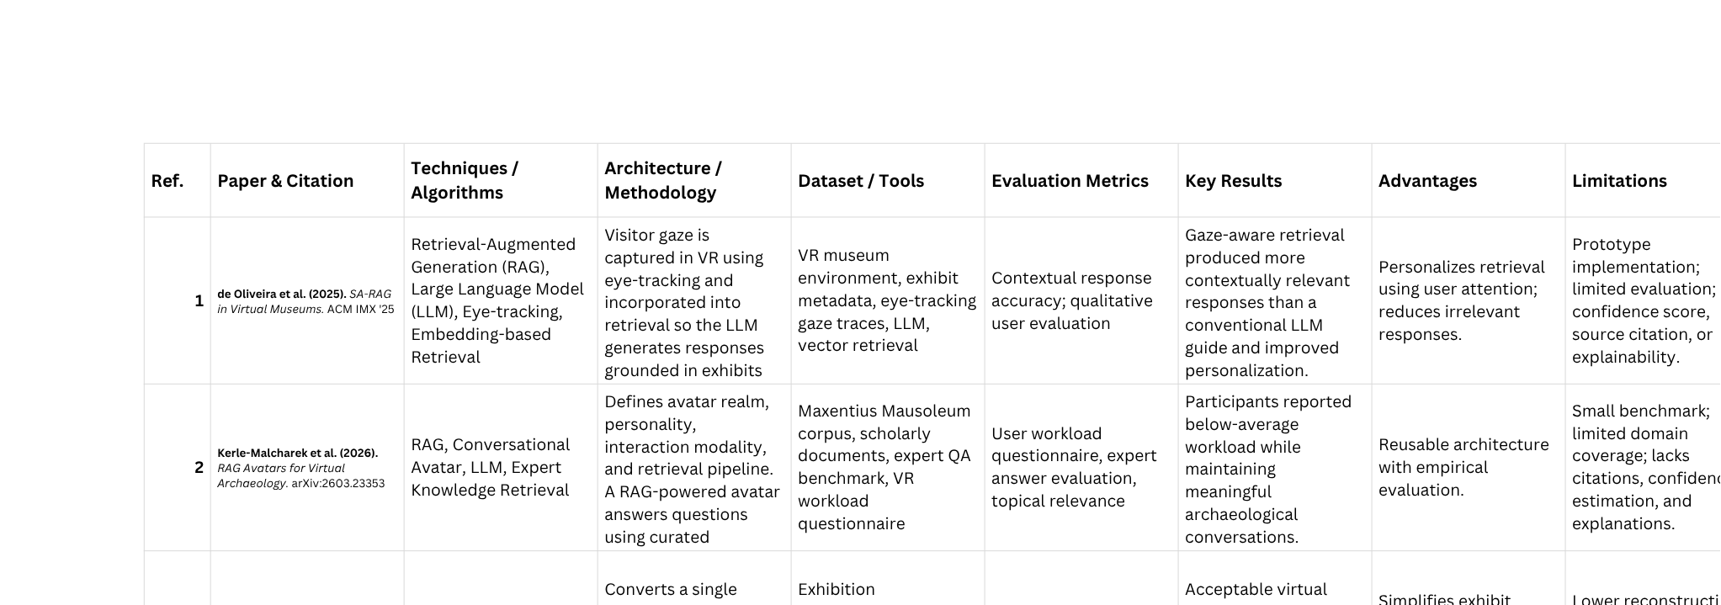

Slide 10
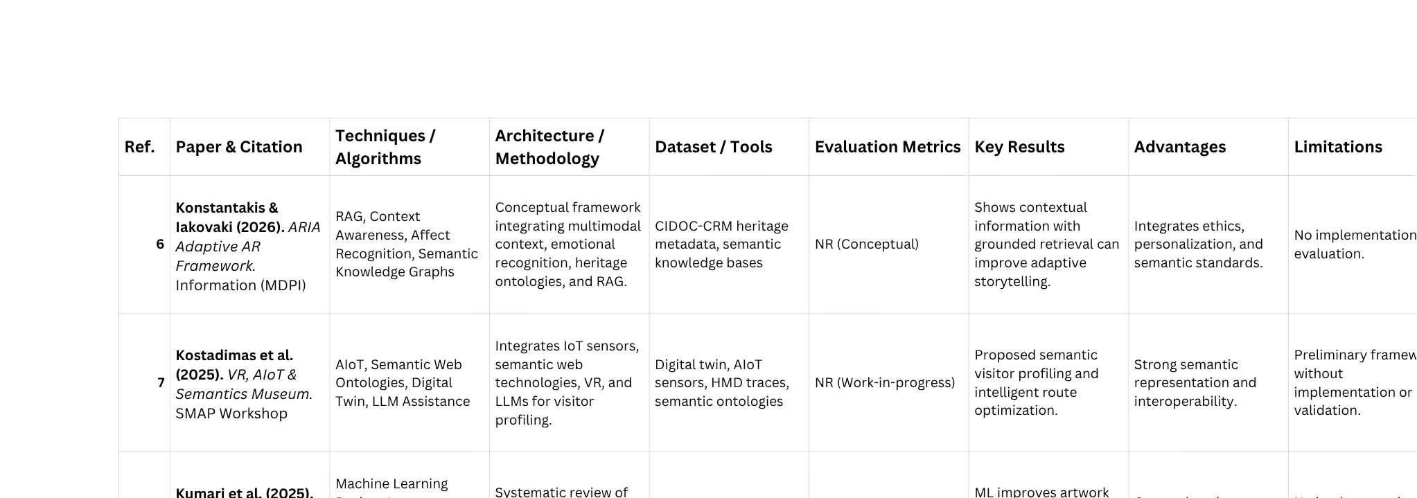

Slide 11
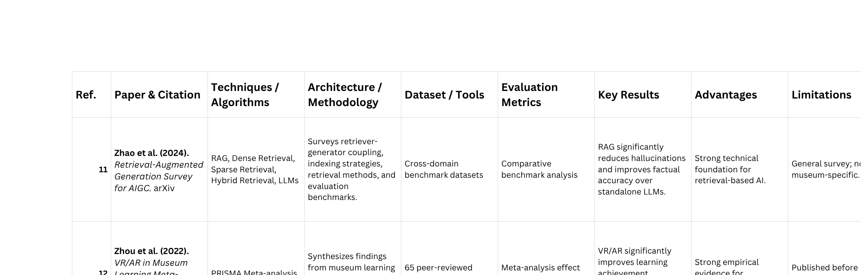

Slide 12
PROBLEM STATEMENT
  Existing virtual museums provide AI-based explanations but often operate as black-box systems.
  AI responses lack transparency, making it difficult for users to verify information.
  Limited context awareness, with minimal consideration of user history, exhibit location, and conversation context.
  Absence of source attribution, confidence scores, and explainable reasoning reduces user trust.
  Most existing solutions focus on either personalization or immersion, but not both with explainability.
  Few systems integrate AR, RAG, Context Awareness, and Explainable AI into a unified platform.
  Need: Develop a Context-Aware Explainable AI Curator that delivers accurate, personalized, and evidence-backed responses with source citations and confidence scores to enhance trust and learning.

Slide 13

RESEARCH GAP

Slide 14
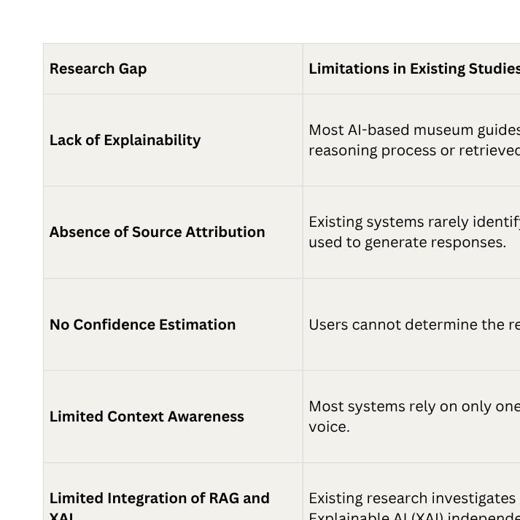

Slide 15
SUMMARY OF THE RESEARCH GAP
The existing literature demonstrates that Retrieval-Augmented Generation (RAG) improves the factual accuracy of AI-generated responses, while Virtual Reality (VR) enhances visitor engagement and context-aware techniques enable personalized museum experiences. However, most current systems focus primarily on generating responses and provide limited transparency regarding how those responses are produced. Key limitations include the lack of Explainable AI (XAI), absence of source attribution, unavailability of confidence estimation, and limited integration of multiple contextual signals into the retrieval process.
Additionally, many existing solutions remain conceptual or prototype-based and have been evaluated using small datasets or limited user studies, restricting their practical applicability and reducing user trust.
The proposed Context-Aware Explainable AI Curator for Virtual Museums using Retrieval-Augmented Generation addresses these research gaps by integrating context-aware retrieval, Explainable AI, source attribution, and confidence scoring into a unified end-to-end framework. By enabling users to understand not only what the AI answers but also why the answer was generated and which knowledge source supports it, the proposed system aims to improve transparency, reliability, user trust, and the overall educational experience in virtual museum environments.

Slide 16
Research Objectives
  Study existing virtual museum systems.
  Design an AI-powered virtual museum.
  Integrate AR with Retrieval-Augmented Generation.
  Develop a context-aware recommendation system.
  Improve response accuracy using trusted sources.
  Provide explainable AI-based responses.
  Evaluate system performance.

Slide 17
Proposed Methodology
Input
  User Query
  Selected Artifact
  Museum Knowledge Base
Output
  AI Explanation
  Source-backed Response
  Personalized Recommendations
Overall Architecture
  AR-based mobile application
  FastAPI backend
  RAG-enabled AI Curator
  MongoDB & ChromaDB storage

Slide 18
Proposed Methodology
Dataset Collection / Selection
  Museum metadata
  Historical documents
  Research articles
  3D artifact models
Data Preprocessing
  Data cleaning
  Text chunking
  Embedding generation
  Vector database indexing
Algorithms / Models Used
  AR Foundation
  Gemini API (LLM)
  (RAG)
  Sentence Transformers
  ChromaDB Vector Search
  Build knowledge base
  Generate embeddings
  Retrieve relevant documents

Slide 19
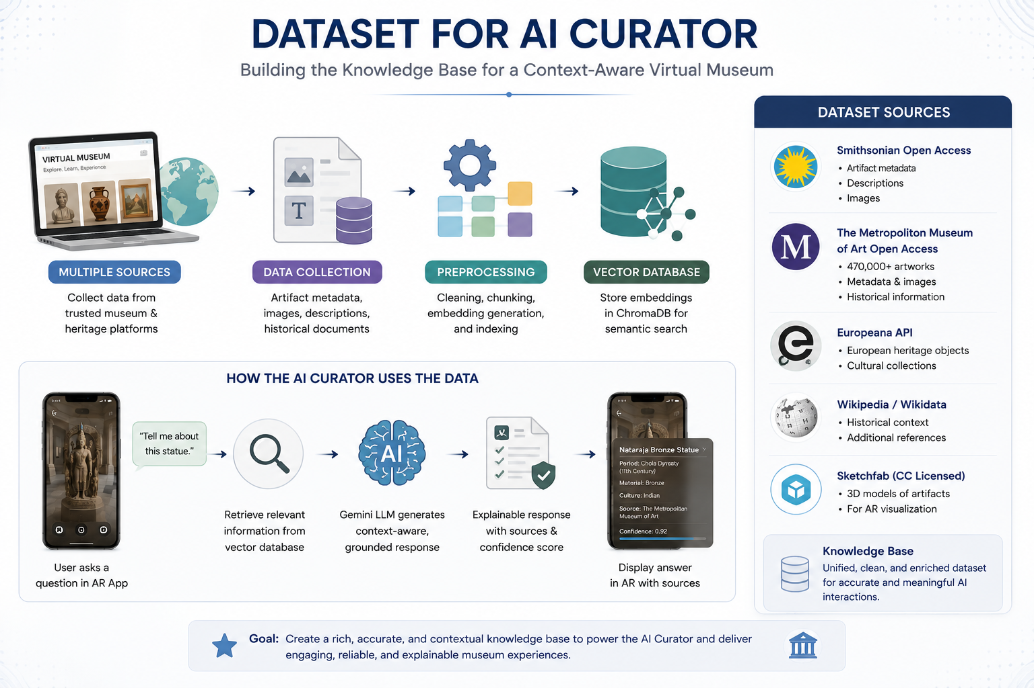

Slide 20
Proposed Methodology
Software Requirements
  Unity 6
  FastAPI
  Python
  MongoDB Atlas
  ChromaDB
  VS Code
Hardware Requirements
  ARCore-supported smartphone
  Laptop (8 GB+ RAM)
Evaluation Metrics
  Response Accuracy
  Response Time
  Retrieval Precision
  User Satisfaction

Slide 21
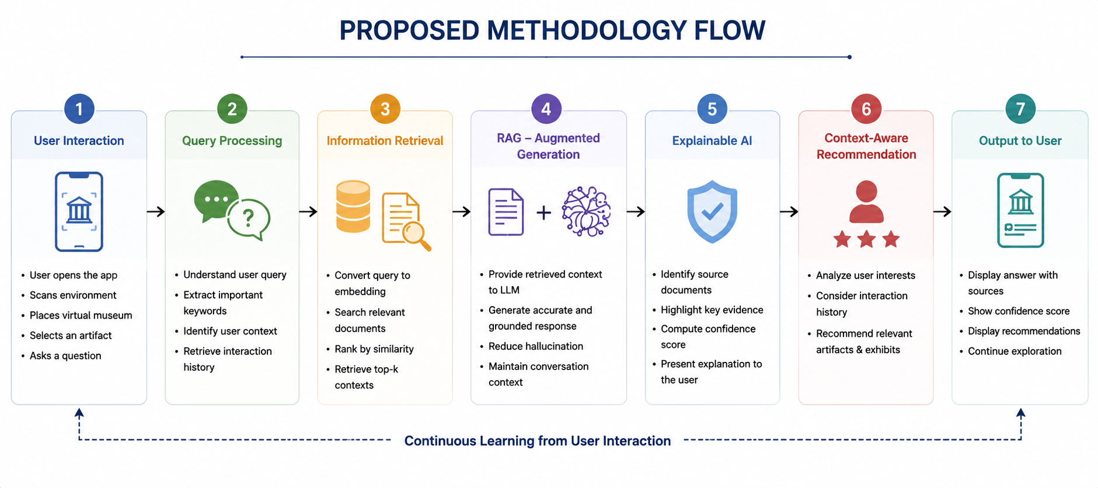

Slide 22
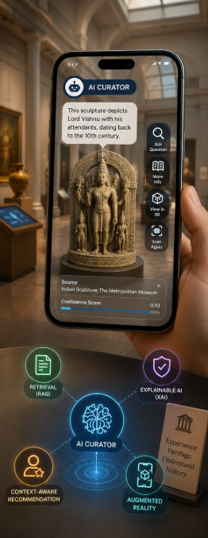
Expected Outcomes
  Interactive smartphone-based AR museum
  Accurate AI-generated explanations
  Personalized artifact recommendations
  Improved user engagement
  Explainable and trustworthy AI responses
  Better accessibility to museum education

Slide 23
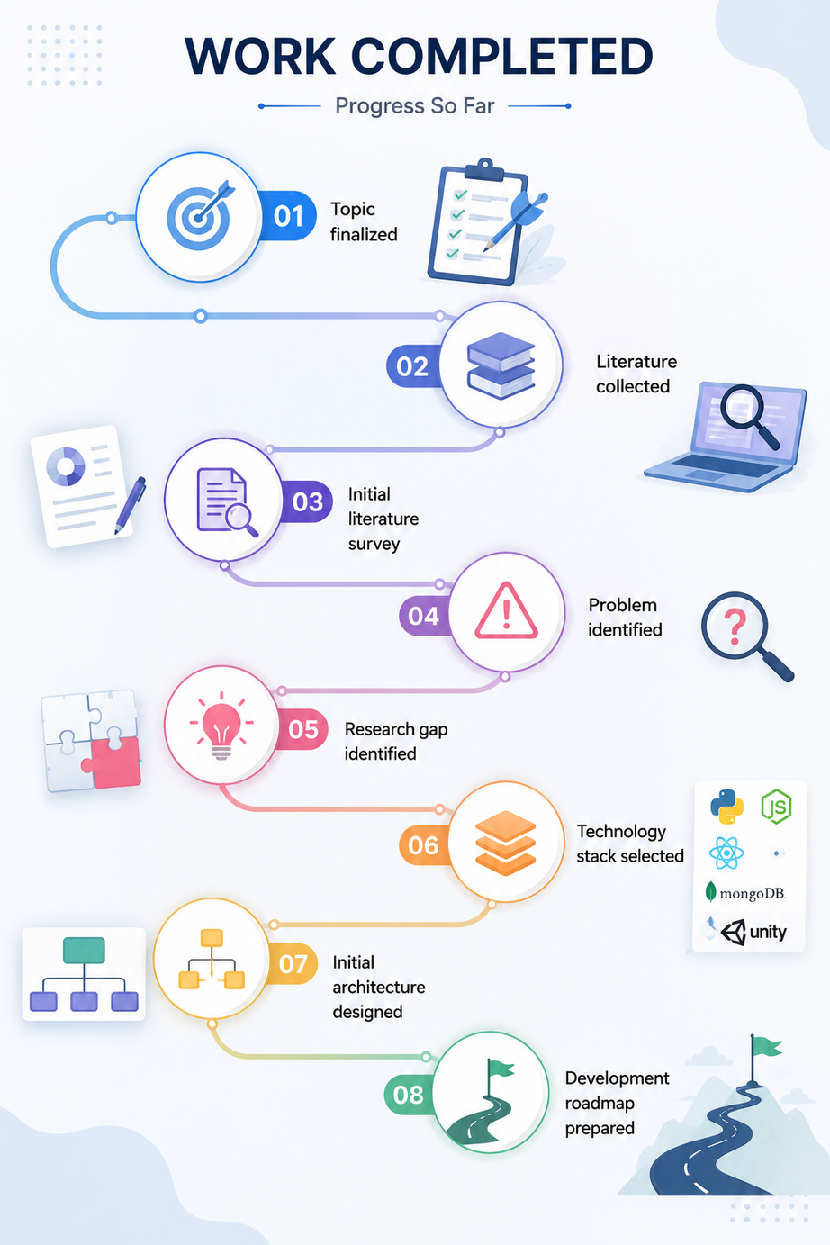
Work Completed
  Topic finalized
  Literature collected
  Initial literature survey
  Problem identified
  Research gap identified
  Technology stack selected
  Initial architecture designed
  Development roadmap prepared

Slide 24
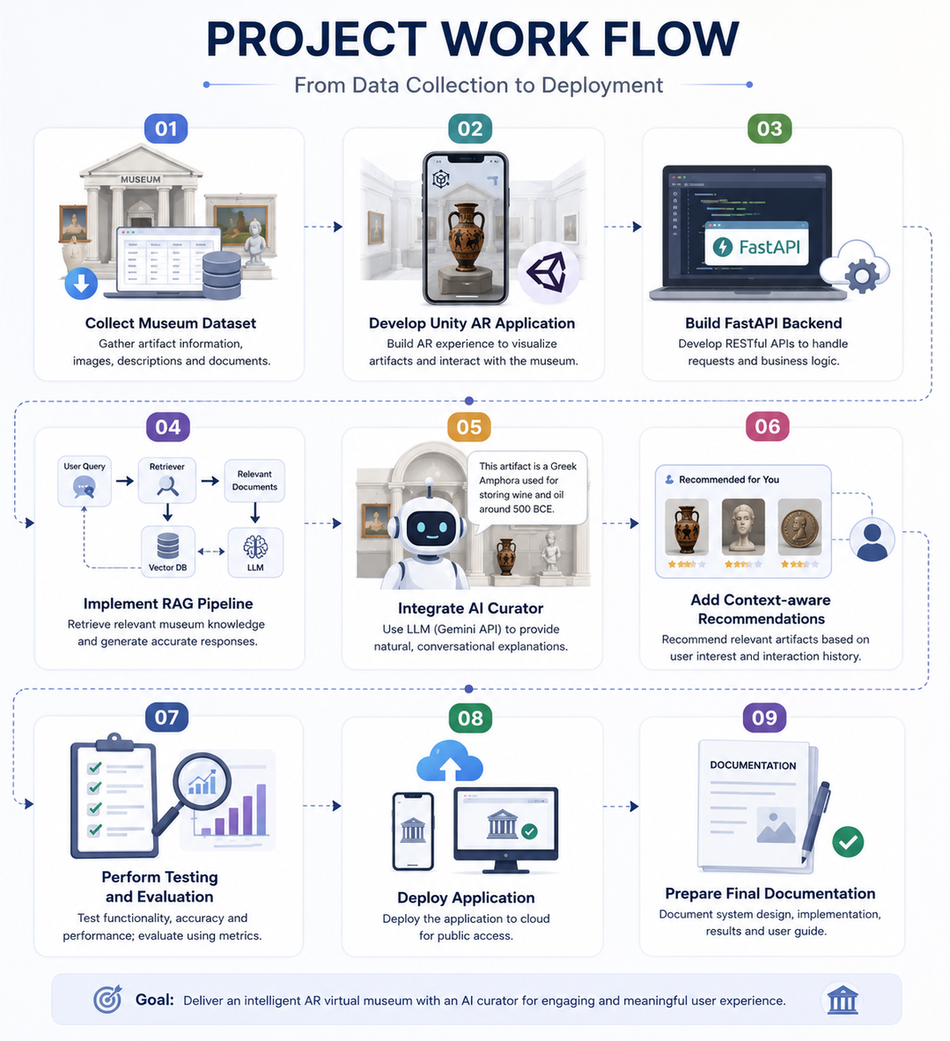
Future Work
  Collect museum dataset
  Develop Unity AR application
  Build FastAPI backend
  Implement RAG pipeline
  Integrate AI curator
  Add context-aware recommendations
  Perform testing and evaluation
  Deploy application
  Prepare final documentation

Slide 25
References
[1] S. F. Adiba and N. Rahmawati, "Exploring GenAI's Role in Digital Cultural Memory at Museums and Art Galleries in Indonesia: AR and VR Perspectives," Springer, 2024.
[2] P. Ariya, S. Khanchai, K. Intawong, and K. Puritat, "Enhancing Textile Heritage Engagement through Generative AI-Based Virtual Assistants in Virtual Reality Museums," Computers & Education: X Reality, Elsevier, 2025.
[3] B. Çakmak and A. Çekmiş, "AI-Directed Procedural Content Generation for Personalized XR in Industrial-Heritage Museums," Frontiers in Virtual Reality, 2026.
[4] E. A. M. de Oliveira et al., "Immersive Virtual Museums with Spatially-Aware Retrieval-Augmented Generation," Proc. ACM Int. Conf. on Interactive Media Experiences (IMX), 2025.
[5] R. B. C. Filho et al., "Image-to-3D for Cultural Heritage: Voice Interaction and Retrieval-Augmented Guidance in VR," Proc. IEEE AIxVR, pp. 300–304, 2026.
[6] W. Kerle-Malcharek et al., "Design Space and Implementation of RAG-Based Avatars for Virtual Archaeology," arXiv, 2026.

Slide 26
References
[7] M. Konstantakis and E. Iakovaki, "ARIA: An AI-Supported Adaptive Augmented Reality Framework for Cultural Heritage," Information, MDPI, 2026.
[8] D. Kostadimas, V. Kasapakis, and K. Kotis, "Exploiting VR, AIoT and Semantics Towards an Adaptive Virtual Museum," Proc. IEEE SMAP, 2025.
[9] P. Kumari et al., "Virtual Art Spaces and Machine Learning Curation," ShodhKosh: Journal of Visual and Performing Arts, 2025.
[10] Z. Li, "Opportunities and Challenges of Artificial Intelligence Enabling Museum Building," Applied Mathematics and Nonlinear Sciences, 2024.
[11] Y. Lin, W. Zhang, and J. Lin, "Question Answering System Based on Retrieval-Augmented Generation," Proc. ACM Int. Conf. on Computer Technology, Digital Media and Communication, 2025.
[12] P. Zhao et al., "Retrieval-Augmented Generation for AI-Generated Content: A Survey," arXiv, 2024.

Slide 27

